Slide 1
NHS Lothian
What’s worked well?
What have been the enablers?
What have been the challenges?
We overcame our challenges by:
Any top tips?

Slide 2
NHS Lothian – What worked well?
Highlighted to clinical management team
Dissemination of change using SBAR
Highlight resources and time requirements
Both initially and as service embeds and develops
Multidisciplinary team involvement
Support and enthusiasm at all levels within maternity services
Early engagement with Medical Physics team
Clinical champion/s
Daily input
Aid in troubleshooting
Support staff
Ensure process in place

Slide 3
Challenges
Resource
Individual packs for PILs and consent forms for ease of use
Designated space with computer, telephone and photocopying
Filing system for completed consent forms
Formal process for return of machines being negotiated
Staff
Face to face familiarisation and training crucial
Reassurance
Empowerment
Process will be refined on local experience, feedback and requirement

Slide 4
Top tips
Familiarisation
Paperwork
Florence
Recruitment
Designated time for staff training
Elaine Jack – Cross site training
START RECRUITMENT

Slide 5
Next steps
Postnatal implementation pathway
East Lothian (remote area)
Use of Near me
Pathways for Type 1 and type 2 diabetes and Multiple pregnancy patients
Setup Consultant led HT clinic
Preconception counselling
PN debrief
Referral into adult HT services as required

Slide 6
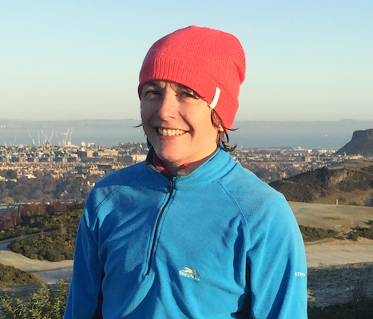
Evaluation
Data-driven evaluation
Routinely recorded data
Evaluate patient pathway - uptake and equity of access
Health economic evaluation
Qualitative research
Semi-structured interviews with women and staff
Lothian, Lanarkshire and Highlands and Islands

