Slide 1
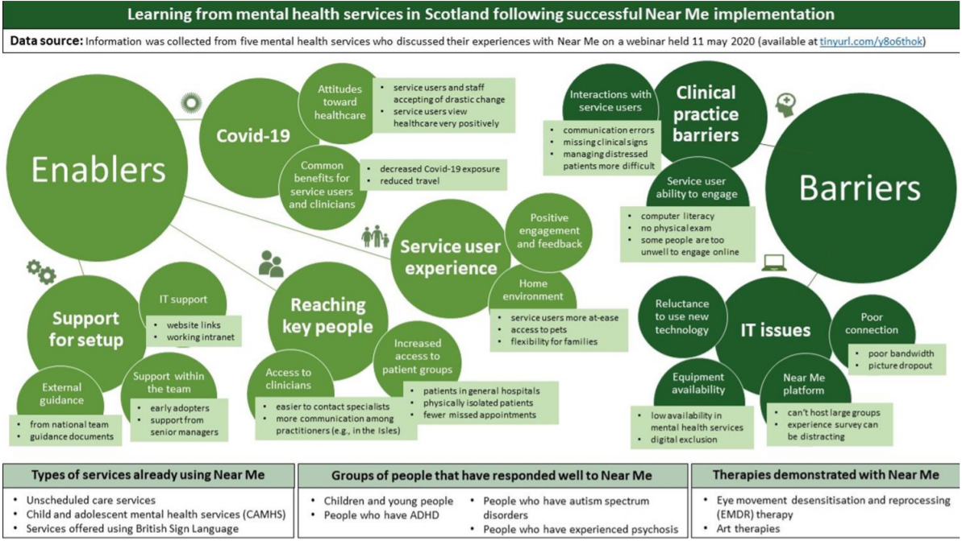
28 May 2020: Mental Health Services – Learning from Implementation of NHS Near Me

