Slide 1
Using technology to support remote maternity care
May 2020

Slide 2
Midwifery and Obstetrics – Why focus on this area?
Covid-19 social distancing requirements:
All pregnant women to self isolate
Specific shielding requirements for people with specific medical conditions
Reduce numbers of women coming to clinical settings for routine appointments
Reduction in the numbers of midwives and obstetricians available for routine appointments
Support for all women but especially complex women to manage their care at home to detect pre-eclampsia

Slide 3
What is being proposed? 1. Enabling specific high risk groups of women to monitor blood pressure remotely and test urine
To do this –
A large quantity of blood pressure monitors validated for use in pregnancy have been procured nationally by the Scottish Government.
Guidance for clinicians has been produced by a clinical oversight group.
An information leaflet for women on how to monitor blood pressure and test urine has been developed.

Slide 4
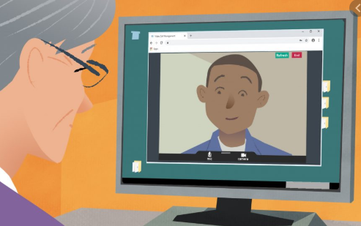
What is being proposed? 2. Enabling appointments to be carried out remotely using technology
To do this –
HIS and the NHS Near Me team have been working
with Boards to introduce NHS Near Me.
An information leaflet for women on how to operate NHS Near Me has been developed.
Training for clinicians on operating NHS Near Me is available on TURAS

Slide 5
Who is included?
Home monitoring will be initially targeted to women at high-risk of hypertensive complications or who are ‘shielded’ because of serious underlying medical conditions (Group 1).
Boards will subsequently roll this out to women identified at increased risk of hypertensive complications (Group 2).
Subject to ongoing availability of monitors and successful roll-out of home monitoring to women in Groups 1 and 2, Boards may wish to extend roll-out to women in Group 3.

Slide 6
How do we do this?
Each Board has an obstetric lead and maternity lead who will inform you of your local processes for:
Delivery and labelling of BP monitors.
How to identify suitable women to take part in remote monitoring.
How women will record and report their remote monitoring results
The frequency of monitoring and reporting blood pressure readings and urinalysis results.
The return process for BP monitors distributed to women.
What appointments technology can be used for, and which technology will be used.

Slide 7
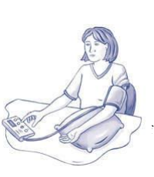
How to distribute home BP monitoring kits to women
Arrange for a woman to attend face to face appointment in maternity assessment unit or antenatal clinic.
Ask her to bring her mobile phone with her to the appointment .
If a woman already has a blood pressure monitor at home ask her to bring it to the appointment so it can be validated as suitable for use in pregnancy and puerperium.
Provide antenatal or postnatal check as usual.

Slide 8
How to distribute home BP monitoring kits to women
Assess eligibility to participate in self-monitoring of blood pressure and urinalysis.
Ensure contact details are up to date on the hospital electronic system (home, mobile phone, number, and email).
Provide an NHS device and an appropriately sized cuff (check upper arm measurement). In some cases, proxy measures may be taken from the forearm.
Complete a blood pressure monitor loan form with the woman, ensuring the asset is appropriately labelled and tracked and informed consent is given

Slide 9
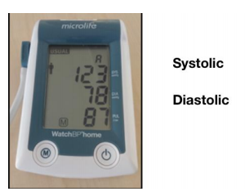
How to distribute home BP monitoring kits to women
Give women the information leaflet on how to take their blood pressure reading, signposting the link to the short video by the British Heart Foundation.
Use teach-back to show the woman how to take her own blood pressure, write down and interpret her results.
Ask the woman to take her blood pressure by herself twice, at least one minute apart, to demonstrate understanding.
This video from the British Heart Foundation might also help
British Heart Foundation

Slide 10
How to distribute home urinalysis kits to women
Give women the information leaflet on how to self-monitor for proteinuria and glycosuria.
Use teach-back to ensure the woman understands how to use the test and where and how to record her results.
Be clear whether this will be done in place of usual care (e.g. on the morning of a scheduled telephone/ virtual clinic appointment) or in addition to usual care (e.g. once a week, three times a week etc.).
It might be helpful to share this video from the manufacturer –
https://pep.siemens-info.com/en-us/clinitek-status-plus-visual-urinalysis-video

Slide 11
Reporting results
Let women know your local arrangements to report their results using a system (e.g. BadgerNet or Florence), ensure this is set up and she is able to log-in before she leaves the clinic.
Use teach-back to show her where and how to record her results. Ask her to demonstrate that she is able to do this, preferably using her own mobile phone or tablet.

Slide 12
Escalation process
Please highlight to women the information in the leaflet on when to contact the hospital if they develop raised blood pressure, new proteinuria/increasing proteinuria, or new symptoms.
Please also ensure they are clear that the normal processes for reporting a change in their health or pregnancy still apply so they know where to seek advice.

Slide 13
Follow up process
Book the next appointment with the woman and discuss whether this will be face-to-face or using technology.
Inform the GP that the woman is undertaking home blood pressure monitoring
Explain the local arrangements to the woman for the return of the blood pressure monitor

